Slide 1
FINAL PROJECT
APPLICATION OF GRAPH THEORY IN
AIR-TRANSPORTATION NETWORK
DONE BY : MUTHUSELVAN S
UNDER THE GUIDANCE OF : PROF MS. V. NANDHINI

Slide 2
GRAPH THEORY
Definition : In mathematics, graph theory is the study of graphs, which are mathematical structures used to model pairwise relations between objects. A graph in this context is made up of vertices (also called nodes or points) which are connected by edges (also called links or lines).

Slide 3
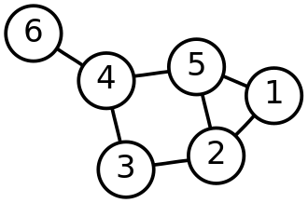
A distinction is made between undirected graphs, where edges link two vertices symmetrically, and directed graphs, where edges link two vertices asymmetrically. Graphs are one of the principal objects of study in discrete mathematics.

Slide 4
INTRODUCTION TO AIR TRANSPORTATION NETWORK
An air transport network or air transportation network is a transport network focused on air routes. Airports serve as the nodes of the network with air routes providing links between them. Air transport networks can be defined worldwide as well as for one region or for one airline company; the scale of the network can be global or domestic.
The worldwide air transportation network is represented by the database of International Air Transport Association (IATA). The worldwide air transportation network is a critical infrastructure with high impact on mobility, trade and economy.

Slide 5
GRAPH THEORY IN AIR TRAFFIC CONTROL NETWORK
Air traffic control is an essential element of the communication structure
which supports air transportation. Two basic for air traffic control (ATC)
are safely and efficiency of air traffic movement. ATC organizes the air space
to achieve the objective of a safe, expeditious and orderly flow of air traffic.
The increasing range of aircraft technology means more attention to the
allotment of air space.

Slide 6
The problem is future compounded by the fact that busy airports sustain excessive lending and departure rates and airports themselves are invariably situated within busy terminal areas and in close proximity to other airports. Future more, these airports are often sited near the junction of air routers serving other destinations.
The term air traffic control is defined as service provided for the purpose of
Preventing collision between aircraft on the air.
Assist in preventing collision between aircraft moving on the apron or the
maneuvering area.
Expedite and maintain an orderly flow of air traffic and

Slide 7
A graph is defined as a finite number of points (known as airports or vertices) connected by lines (known as edges or arcs). In this paper for a given graph find a minimum cost to find the shortest path between two airports.
There are different path options to reach from airport A to airport B, but
our aim is to find the shortest path with a minimum transportation costs,
this requires a lot efforts.

Slide 8
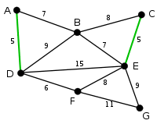
KRUSKAL’S ALGORITHM
Kruskal's algorithm finds a minimum spanning forest of an undirected edge-weighted graph. If the graph is connected, it finds a minimum spanning tree. The key steps of the algorithm are sorting and the use of a disjoint-set data structure to detect cycles. Its running time is dominated by the time to sort all of the graph edges by their weight.

Slide 9
DIJKSTRA'S ALGORITHM
Dijkstra's algorithm is an algorithm for finding the shortest paths between nodes in a weighted graph, The algorithm exists in many variants. Dijkstra's original algorithm found the shortest path between two given nodes, but a more common variant fixes a single node as the "source" node and finds shortest paths from the source to all other nodes in the graph, producing a shortest-path tree

Slide 10
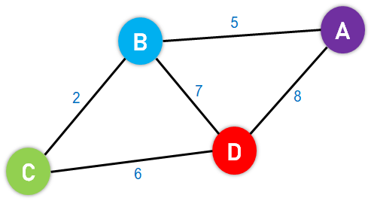
DIJKSTRA'S ALGORITHM
The Dijkstra algorithm uses labels that are positive integers or real numbers, which are totally ordered.

Slide 11
THANK YOU

